Slide 1
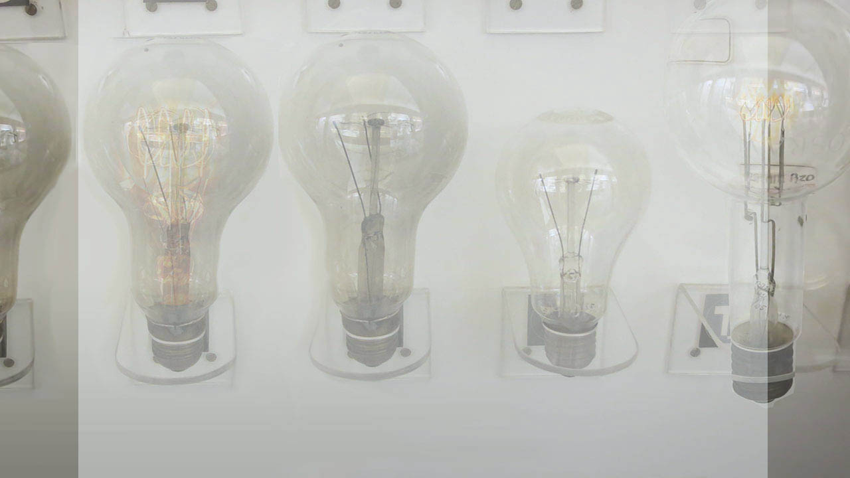
Introductory Concepts Pt 2:
To recap:
More details about circuits

Slide 2
To recap:
What is a conductor?

Slide 3
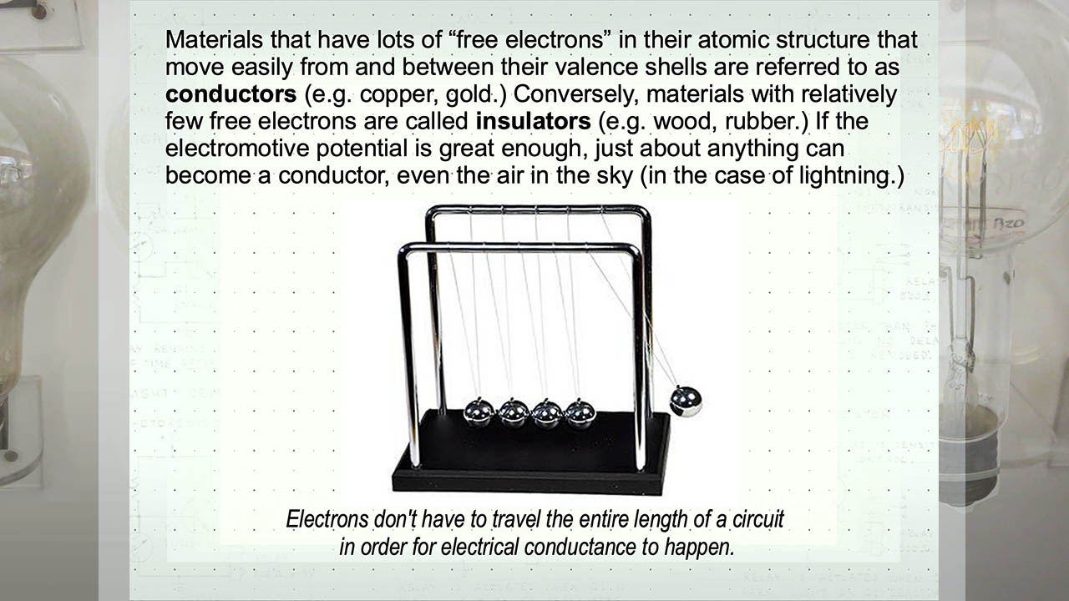
To recap:
What is a conductor?

Slide 4
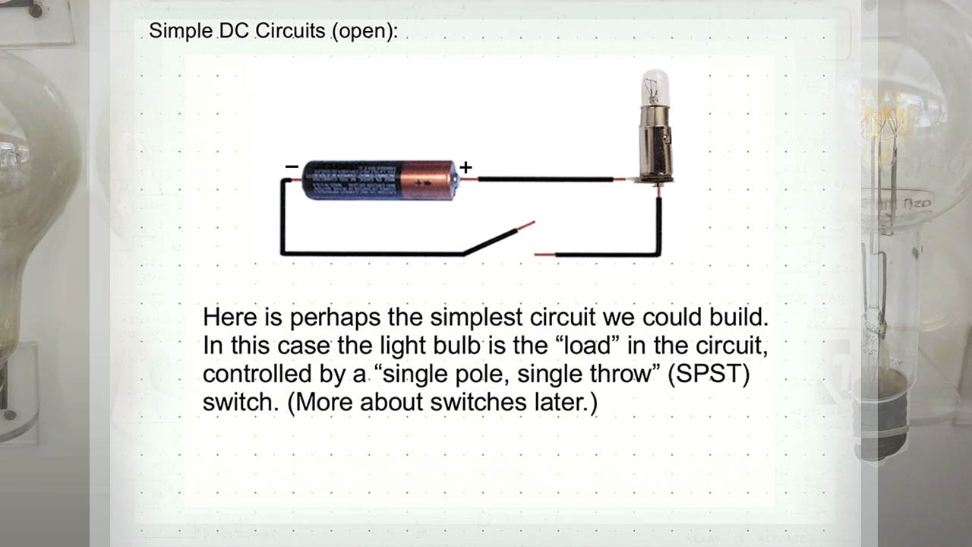
To recap:

Slide 5
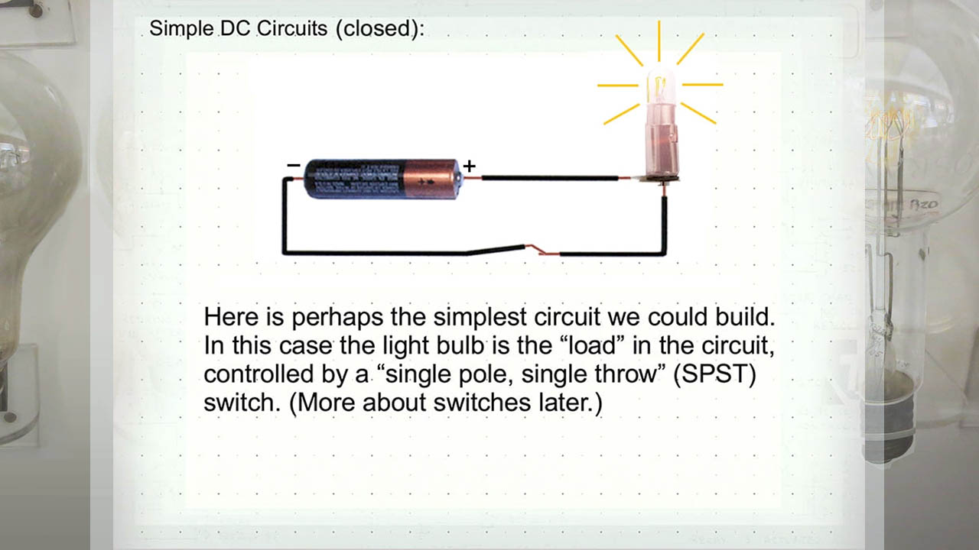
To recap:

Slide 6
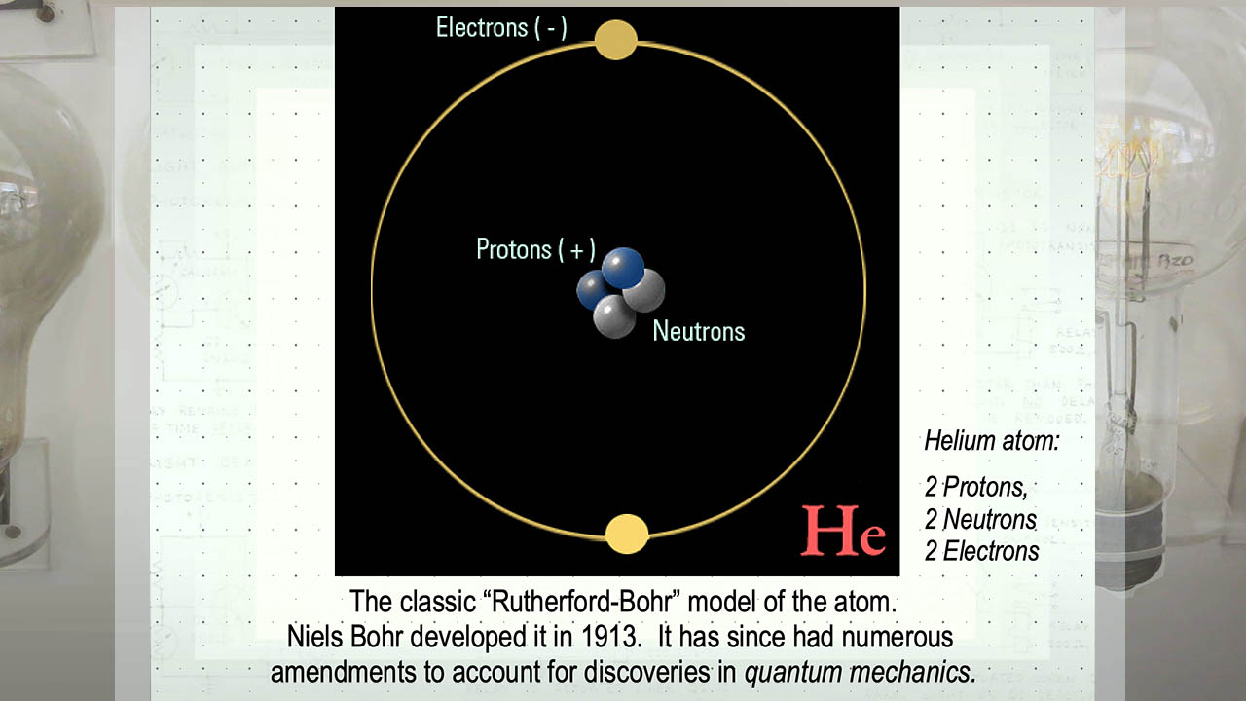
To recap:

Slide 7
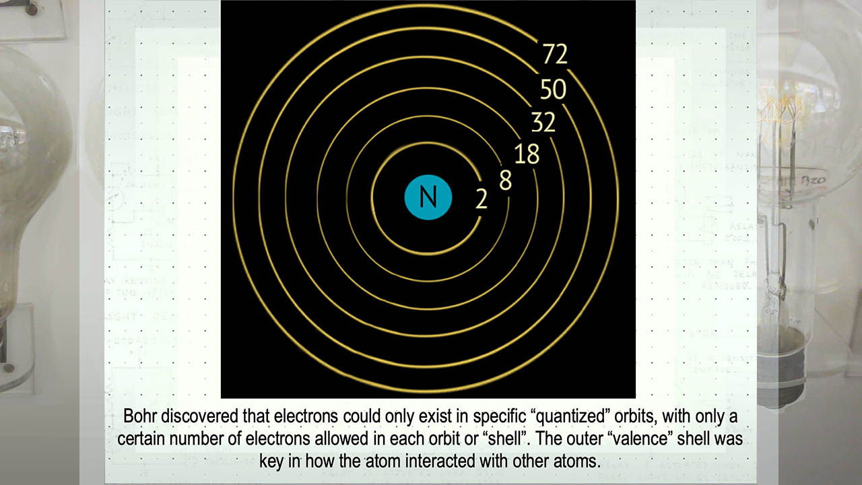
To recap:

Slide 8
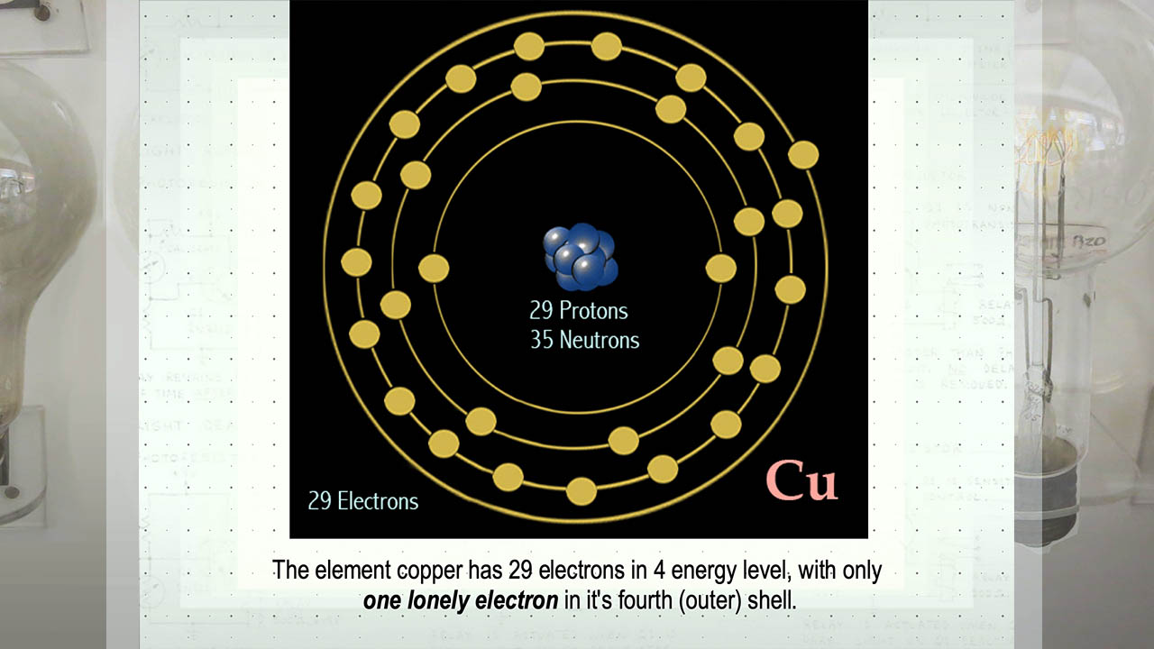
To recap:

Slide 9
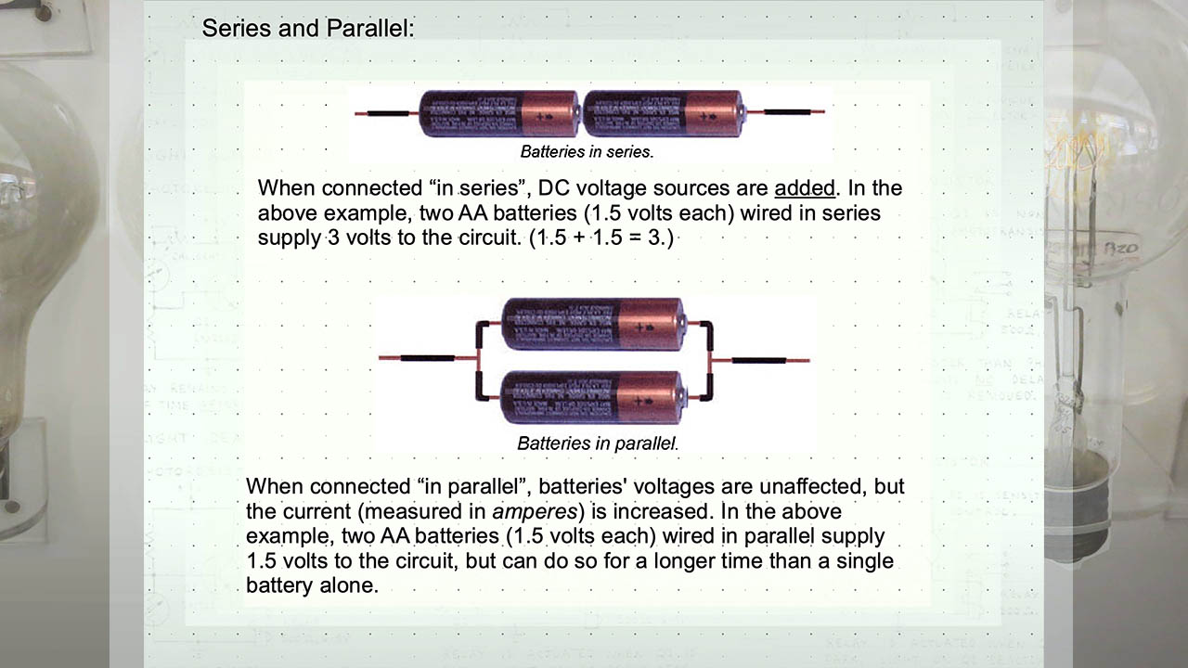
To recap:

Slide 10
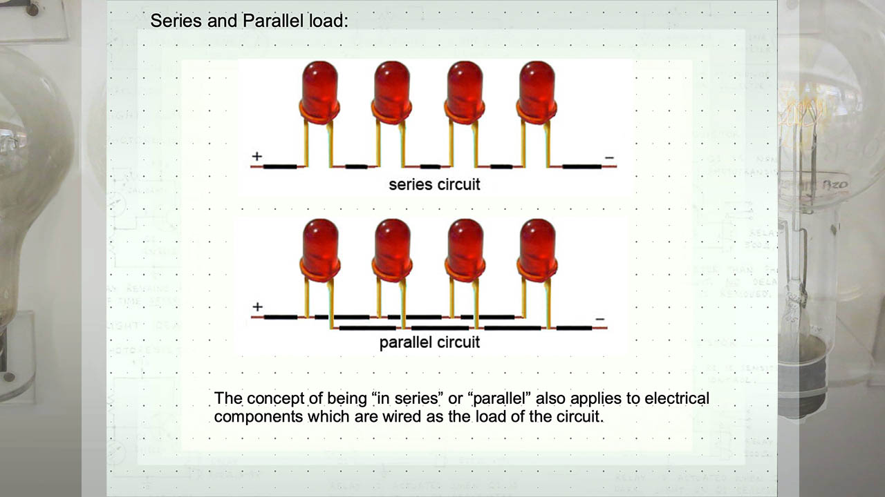
To recap:

Slide 11
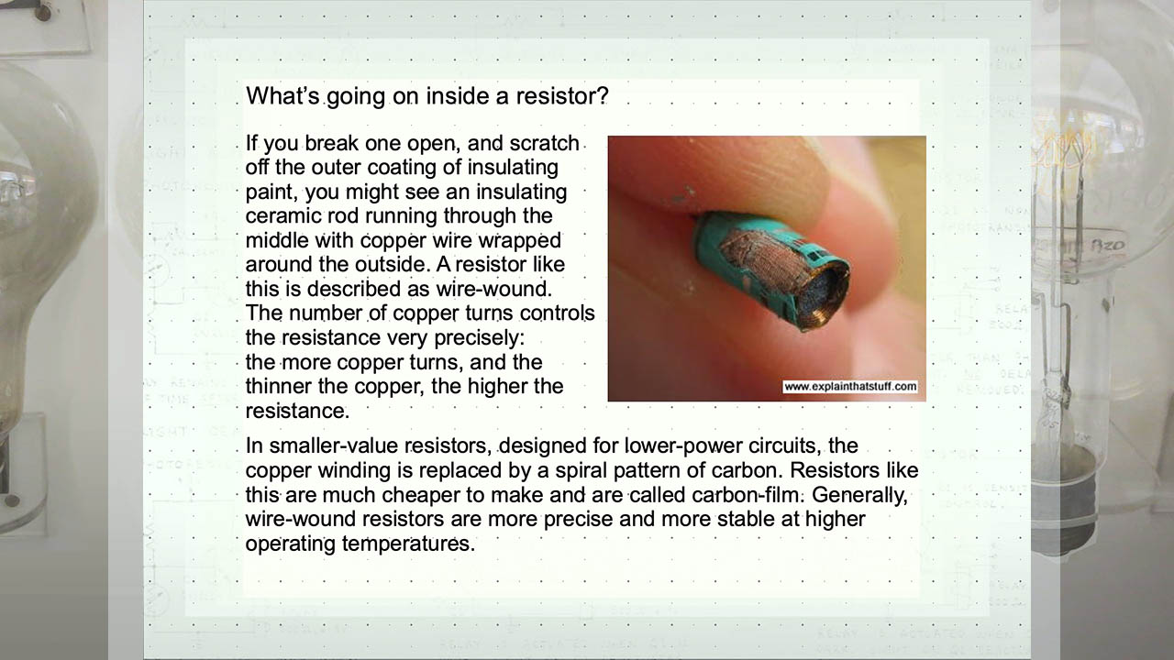
To recap:

Slide 12
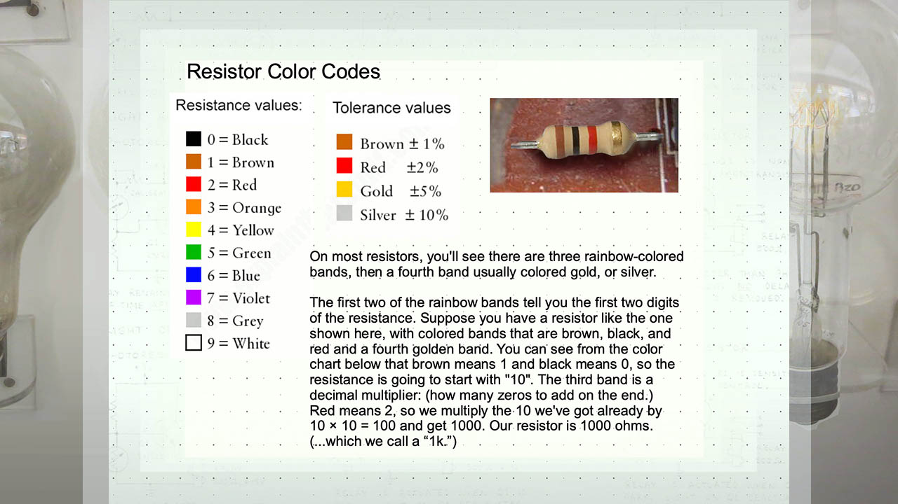
To recap:

Slide 13
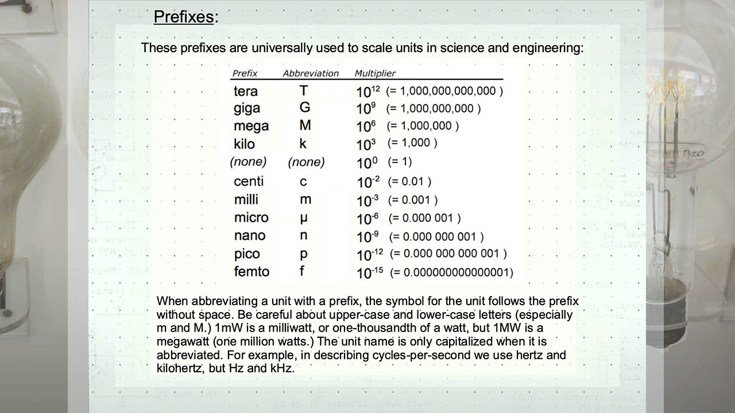
To recap:

